Slide 1
Topics
Transdisciplinary Research Example
Transdisciplinary Education Examples
Searches
Southern Association of Colleges and Schools Commission on Colleges (SACSCOC)
Notes:
Need talking points about these models

Slide 2
Transdisciplinary research example
Which of the following is true regarding coffee?
Caffeine content increases with roasting.
Polyphenols and caffeine content may decrease with roasting.
Half life of caffeine is affected by genetics, age and smoking.
A and C are true.
B and C are true.

Slide 3
Transdisciplinary research example
A Guide to Coffee Roasts from Light to Dark. (n.d.). Crema.co. https://crema.co/guides/coffee-roasts

Slide 4
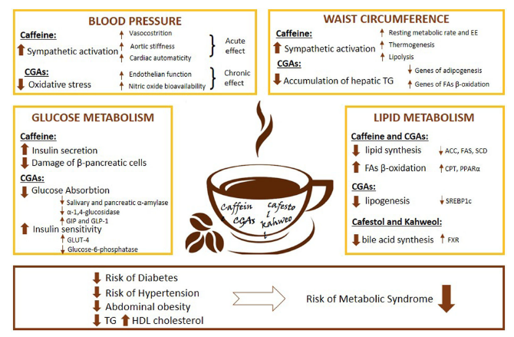
Transdisciplinary research example
Metabolized by CYP1A2 and NAT2
Half life 2.5-4.5 hours
Slow: 12-13%
Intermediate: 51-67%
Rapid: 20-37%
Light or medium roasting is optimal to increase polyphenols and caffeine
Barrea, L., Pugliese, G., Frias-Toral, E., El Ghoch, M., Castellucci, B., Chapela, S. P., Carignano, M., Laudisio, D., Savastano, S., Colao, A., & Muscogiuri, G. (2021). Coffee consumption, health benefits and side effects: a narrative review and update for dietitians and nutritionists. Critical reviews in food science and nutrition, 1–24. Advance online publication. https://doi.org/10.1080/10408398.2021.1963207
Butler, M. A., Lang, N. P., Young, J. F., Caporaso, N. E., Vineis, P., Hayes, R. B., Teitel, C. H., Massengill, J. P., Lawsen, M. F., & Kadlubar, F. F. (1992). Determination of CYP1A2 and NAT2 phenotypes in human populations by analysis of caffeine urinary metabolites. Pharmacogenetics, 2(3), 116–127. https://doi.org/10.1097/00008571-199206000-00003
Notes:
Summary of all major effects of coffee constituents on glucose and lipid metabolism, blood pressure, and waist circumference. Coffee contains many biologically
active substances, including caffeine, chlorogenic acids (CGAs), and diterpenes as cafestol and kahweol, which exert different metabolic effects. Regarding
glucose metabolism, caffeine effect insulin release, predominantly, increasing b-cells secretion and reducing their damage. At the same time, CGAs have different
effects on glucose absorption and insulin sensitivity by inhibiting salivary and pancreatic a-amylase, a-1,4-glucosidase, and glucose-6-phosphatase secretion of
incretins and by inducing the translocation of GLUT-4, responsible for glucose uptake by peripheral tissues. The acute hypertensive effect of coffee is mainly mediated
by caffeine, stimulating sympathetic activation with vasoconstriction, increased aortic stiffness, and cardiac automatism, while in the long-term exposure, CGAs
reduce oxidative stress by improving endothelial function and the bioavailability of nitric oxide, resulting in a reduction in blood pressure following chronic coffee
intake. Regarding the effect of coffee consumption on waist circumference, caffeine stimulates the sympathetic nervous system increasing resting metabolic rate
and energy expenditure, and promotes cellular thermogenesis and lipolysis. Simultaneously, CGAs act to suppress the accumulation of hepatic triglycerides via
down-regulation of genes associated with adipogenesis and up-regulation of genes involved in fatty acid oxidation. Finally, about lipid metabolism, caffeine and
CGAs have been shown to suppress the activity of enzymes for lipid synthesis, acetyl-CoA carboxylase, fatty acid synthase, and stearoyl-CoA desaturase, and to
increase fatty acid b-oxidation by stimulating carnitine palmitoyltransferase and by activating PPAR-a in the liver and adipose tissues. Meanwhile, CGAs alone can
control lipogenesis by down-regulating sterol regulatory element-binding protein (SREBP)-1C. Cafestol and kahweol have been shown to increase blood cholesterol
levels by inhibiting bile acid synthesis acting on farnesoid X receptors. Therefore, habitual coffee consumption has been associated with a reduction in the risk of
diabetes, hypertension, abdominal obesity, a reduction in triglycerides levels, and increased HDL cholesterol levels, resulting in an reduction in the risk of metabolic
syndrome overall.

Slide 5
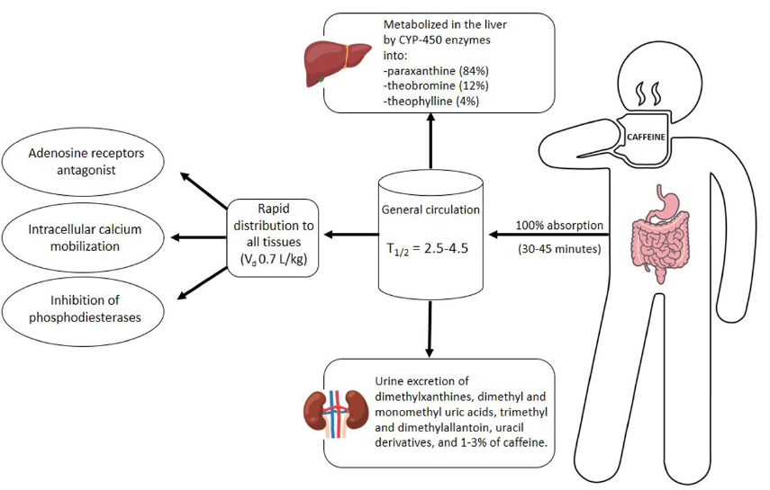
Transdisciplinary research example
Phenolic antioxidants decrease with roasting
Two main species:
Coffea arabica
Coffea robusta
Caffeine 58-259 mg/serving
Coffea canephora and coffea robusta have higher caffeine content, especially light roasted cherry
Half life of caffeine affected by:
Age
Smoking (reduces)
Pregnancy (increases)
Medications
Genetics
Barrea, L., Pugliese, G., Frias-Toral, E., El Ghoch, M., Castellucci, B., Chapela, S. P., Carignano, M., Laudisio, D., Savastano, S., Colao, A., & Muscogiuri, G. (2021). Coffee consumption, health benefits and side effects: a narrative review and update for dietitians and nutritionists. Critical reviews in food science and nutrition, 1–24. Advance online publication. https://doi.org/10.1080/10408398.2021.1963207
Hečimović, I., Belščak-Cvitanović, A., Horžić, D., & Komes, D. (2011). Comparative study of polyphenols and caffeine in different coffee varieties affected by the degree of roasting. Food chemistry, 129(3), 991–1000. https://doi.org/10.1016/j.foodchem.2011.05.059
Notes:
An overview of pharmacokinetics of caffeine. Caffeine is absorbed into the systemic circulation within about 45 minutes its ingestion and peak blood concentrations
are reached within about 1.5 hours. However, about 90% is cleared from the stomach within 20 minutes. The kidney tubules promptly reabsorb caffeine,
and only about 5% is excreted unchanged in urine within 48 h; in reverse, infants excrete 85% in urine. Different factors affect the half-life of caffeine, including
gender (20–30% shorter in women), age (preterm neonates, 50–100 hours), pregnancy (9–11 h), smoking (1.5–3.5 h), hepatic function (96 h), and use of certain concurrent
drugs (such as oral contraceptives, cimetidine or ciprofloxacin that increase its half-life, and carbamazepine or rifampicin decrease its half-life). Caffeine,
occupying adenosine receptor sites, can act as a competitive inhibitor of brain receptors and increase alertness. Caffeine is metabolized mainly in the liver microsomal
cytochrome P450 system by the CYP1A2 isozyme. In addition, microsomal enzymes biotransform caffeine metabolites filtered by the kidneys and excreted in
the urine.

Slide 6
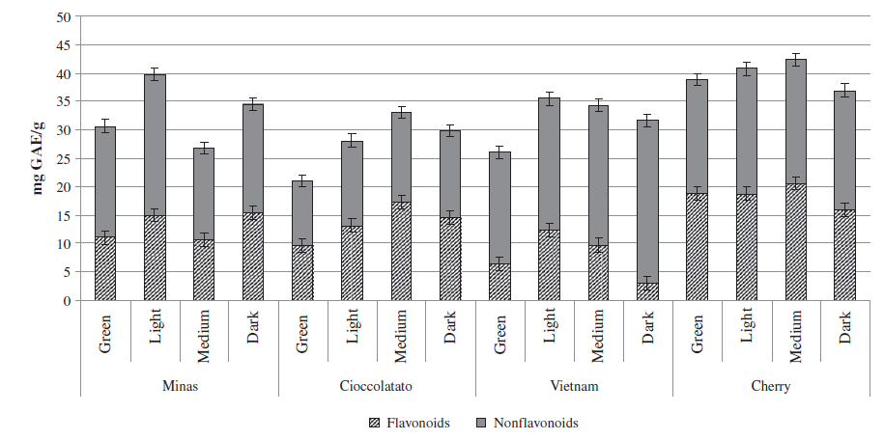
Transdisciplinary research example: flavonoid content based on roasting
Hečimović, I., Belščak-Cvitanović, A., Horžić, D., & Komes, D. (2011). Comparative study of polyphenols and caffeine in different coffee varieties affected by the degree of roasting. Food chemistry, 129(3), 991–1000. https://doi.org/10.1016/j.foodchem.2011.05.059
Notes:
The content of caffeoylquinic acid (QCA) derivatives (mg QCA)/g) of coffees affected by different roasting degrees. The content of chlorogenic acid derivatives was
significantly (p<0.05) affected by different coffee varieties, and not significantly (p>0.05) affected by the roasting degrees.

Slide 7
Transdisciplinary research example
Sarah Lyon, Ph.D.

Slide 8
Provost Report
Transdisciplinary Research Example
Transdisciplinary Education Examples
Searches
Southern Association of Colleges and Schools Commission on Colleges (SACSCOC)

Slide 9
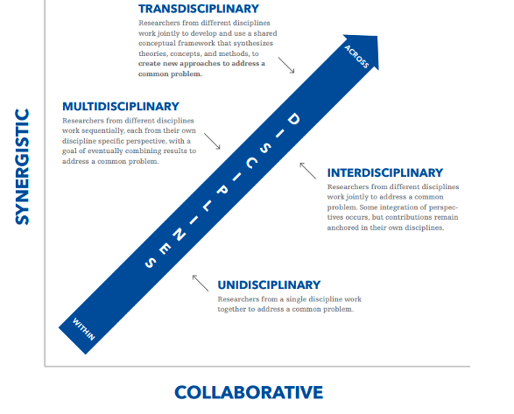
Transdisciplinary educational examples: alignment with strategic plan
Rosenfield P. L. (1992). The potential of transdisciplinary research for sustaining and extending linkages between the health and social sciences. Social science & medicine (1982), 35(11), 1343–1357. https://doi.org/10.1016/0277-9536(92)90038-r

Slide 10
Transdisciplinary education examples
The UK-PURPOSE (Plan for Unprecedented Research, Purposeful and Optimal Service and Education)
Putting Students First (SF):
Objective 2 (SF2): Expand on the existing foundation of a focused, intentional, purpose-driven curricular and co/extra-curricular experience with state-wide and global relevance, led and fostered by faculty and staff excellence.
Inspiring Ingenuity (II):
Objective 2 (II2): Advance a culture of innovation in research, teaching and creative work that integrates disciplines and/or fields of study to address local, national and international challenges.
Notes:
Putting Students First (SF):
Objective 2 (SF2): Expand on the existing foundation of a focused, intentional, purpose-driven curricular and co/extra-curricular experience with state-wide and global relevance, led and fostered by faculty and staff excellence.
Tactic: Through faculty-driven processes, expand in person and online curricular offerings that are relevant to the Commonwealth’s economic and societal needs leveraging our niche as a comprehensive campus for cross-college and unit opportunities to develop transdisciplinary programs/majors/certificates at the undergraduate, graduate and professional levels.
Inspiring Ingenuity (II):
Objective 2 (II2): Advance a culture of innovation in research, teaching and creative work that integrates disciplines and/or fields of study to address local, national and international challenges.
Tactic: Support programming and platforms for research and creative expression that engages a broader cross section of the campus, accelerates career development and catalyzes transdisciplinary research and educational initiatives.

Slide 11
Transdisciplinary education examples
Neuroscience Bachelor of Science
College of Agriculture, Food and Environment, College of Arts and Sciences, College of Medicine and College of Pharmacy
Undergraduate degree program with premedical and non-premedical paths
Wide range of career opportunities for graduates
Notes:
The Neuroscience undergraduate major is a collaboration between Neuroscience (COM) and Biology and Psychology (A&S).

Slide 12
Transdisciplinary education examples
Agriculture Nursing Scholars Program
College of Agriculture, Food and Environment, College of Nursing and Center for Interprofessional Health Education
Four and a half-year, full-time program
Students receive Bachelor of Science in Dietetics and Human Nutrition and Accelerated Bachelor of Science in Nursing
Scholarship funding made possible by Women & Philanthropy and donor support
Addresses workforce needs in rural or underserved areas
Notes:
The College of Nursing received Woman & Philanthropy funding to create the AG Nursing Scholars Program for Kentucky Rural Health and Wellness. This program is a partnership with the University of Kentucky (UK) College of Agriculture, Food and Environment (CAFÉ), the Center for Interprofessional Health Education (CIHE) and the UK College of Nursing (UK CON) to position undergraduate CAFÉ Dietetics and Human Nutrition (DHN) majors, with an interest to advance health and wellness in rural Kentucky, for academic and career success through Bachelor of Science in Nursing (BSN) education. As a result of the partnership and W&P funding support, five $10,000 scholarships are awarded for DHN students to earn a Bachelor of Science (BS) in 3 years while preparing for a seamless admission as a second- degree student in the UK Accelerated BSN (ABSN) program with degree completion in 18 months as AG Nursing Scholars.

Slide 13
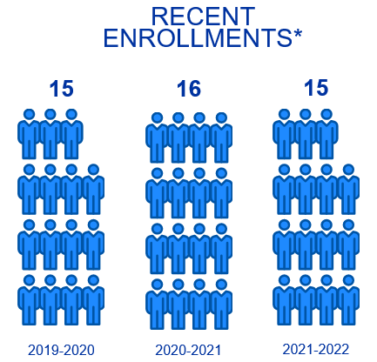
Transdisciplinary education examples
Engineering/MBA dual degree program
Gatton College of Business and Economics and College of Engineering
One-year, full-time program beginning each summer
Highly competitive program, with scholarship funding made possible via 2007 endowment
Open only to graduates of UK’s undergraduate engineering programs to enable them to:
Gain business acumen
Strengthen their teaming, management and leadership skills
Gain international exposure
Explore new career options
*Based on endowment funding for scholarships, enrollment targeted as 15 Engineering/MBA dual degree candidates per year
Notes:
One of our longstanding transdisciplinary programs is the University of Kentucky Engineering/MBA dual degree program (https://gatton.uky.edu/programs/mba/programs/dual-degrees). This degree was launched in 1996. Mr. Jim Stuckert provided an endowment in 2007 which allowed us to continue to offer the program. The program is currently a one year fulltime program that begins each summer. We have admitted the following number of dual degree students in recent years:
Summer 2021: 15, Summer 2020: 16 and Summer 2019: 15 students were admitted. Scholarships are available consisting of $25,000 towards tuition, plus an additional $5,000 towards their study abroad experience (which consists of a two-week study abroad experience to expose students to nuances in business and cultural practices in Europe). A summary of the career outcomes for graduates of this program are available at the program website (https://gatton.uky.edu/programs/mba/programs/dual-degrees)

Slide 14
Provost Report
Transdisciplinary Research Example
Transdisciplinary Education Examples
Searches
Southern Association of Colleges and Schools Commission on Colleges (SACSCOC)
Notes:
Need talking points about these models

Slide 15
searches
Dean, College of Arts and Sciences
Search committee co-chairs: Jay Miller and Carrie Oser
Dean, Graduate School and Associate Provost for Graduate and Professional Education
Search committee co-chairs: Scott Lephart and Corrine Williams
Dean, College of Nursing
Search committee co-chairs: pending
Associate Provost for Faculty Advancement
Search committee co-chairs: Katie Cardarelli and Mark Shanda
Chellgren Chair and Director, Chellgren Center for Undergraduate Excellence
Search committee chair: Sue Roberts
Associate Vice President/Associate Provost for Diverse Faculty Success

Slide 16
Provost Report
Transdisciplinary Research Example
Transdisciplinary Education Examples
Searches
Southern Association of Colleges and Schools Commission on Colleges (SACSCOC)

Slide 17
QUALITY ENHANCEMENT PLAN (QEP)
Broad engagement and input on Quality Enhancement Plan (QEP) topics resulted in 18 broad potential themes
Five themes emerged as most aligned to Strategic Plan
Campus-wide survey launched for feedback regarding these themes
Ran from November 16-December 3, 2021
Publicized in two campus-wide messages from President Capilouto
Received hundreds of responses

Slide 18
QUALITY ENHANCEMENT PLAN (QEP)
Our QEP will focus on Transdisciplinary Educational approaches to advance Kentucky (TEK)
Previously successful in the research enterprise, TEK will apply a transdisciplinary approach to tackling issues around student learning and outcomes:
Creation of programs that have impact and can be integrated with our research and community-wide service efforts
Help students learn and think about real-world problems or themes with a transdisciplinary approach
Implementation team will be formed to develop the QEP

Slide 19
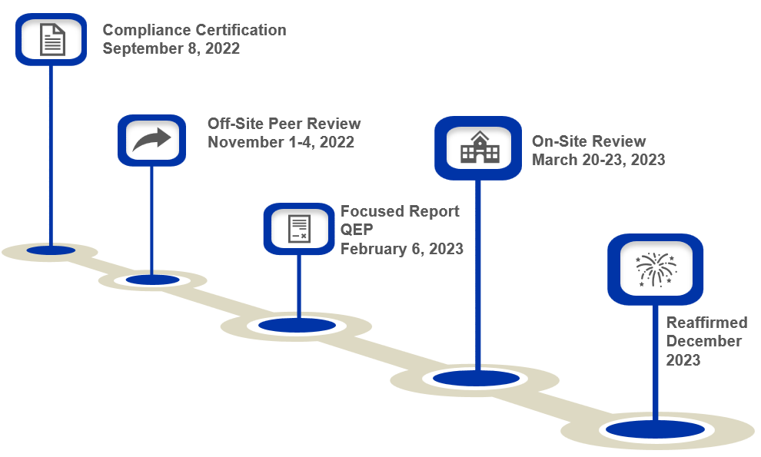
Reaffirmation timeline

Slide 20
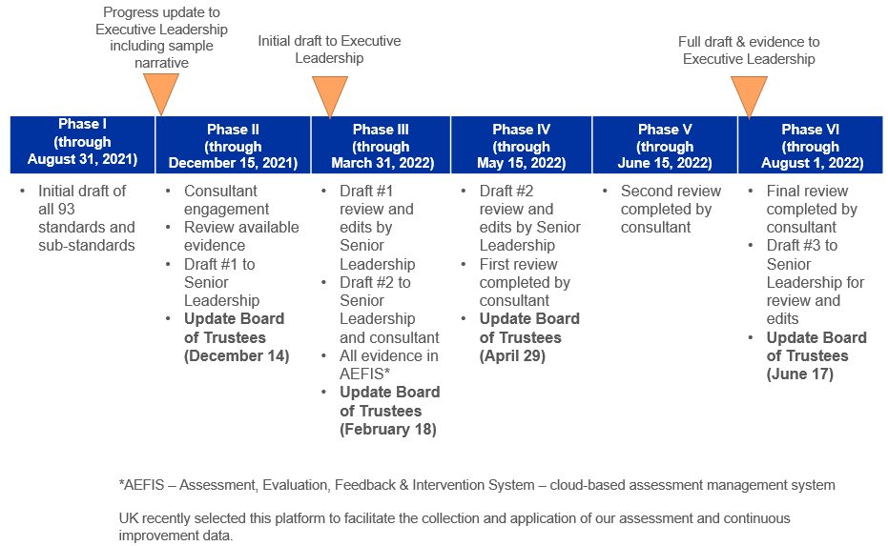
Compliance certification timeline

Slide 21
Provost Report
Transdisciplinary Research Example
Transdisciplinary Education Examples
Searches
Southern Association of Colleges and Schools Commission on Colleges (SACSCOC)

Slide 22
Transdisciplinary research example
Which of the following is true regarding coffee?
Caffeine content increases with roasting.
Polyphenols and caffeine content may decrease with roasting.
Half life of caffeine is affected by genetics, age and smoking.
A and C are true.
B and C are true.

Slide 23
Provost Report
Transdisciplinary Research Example
Transdisciplinary Education Examples
Searches
Southern Association of Colleges and Schools Commission on Colleges (SACSCOC)

Slide 24
Questions

